Slide 1

A Deep Learning Approach for Performance-Based Prediction of Remaining Useful Life
Abel Diaz-Gonzalez, Austin Coursey, Marcos Quinones-Grueiro, and Gautam Biswas

Slide 2

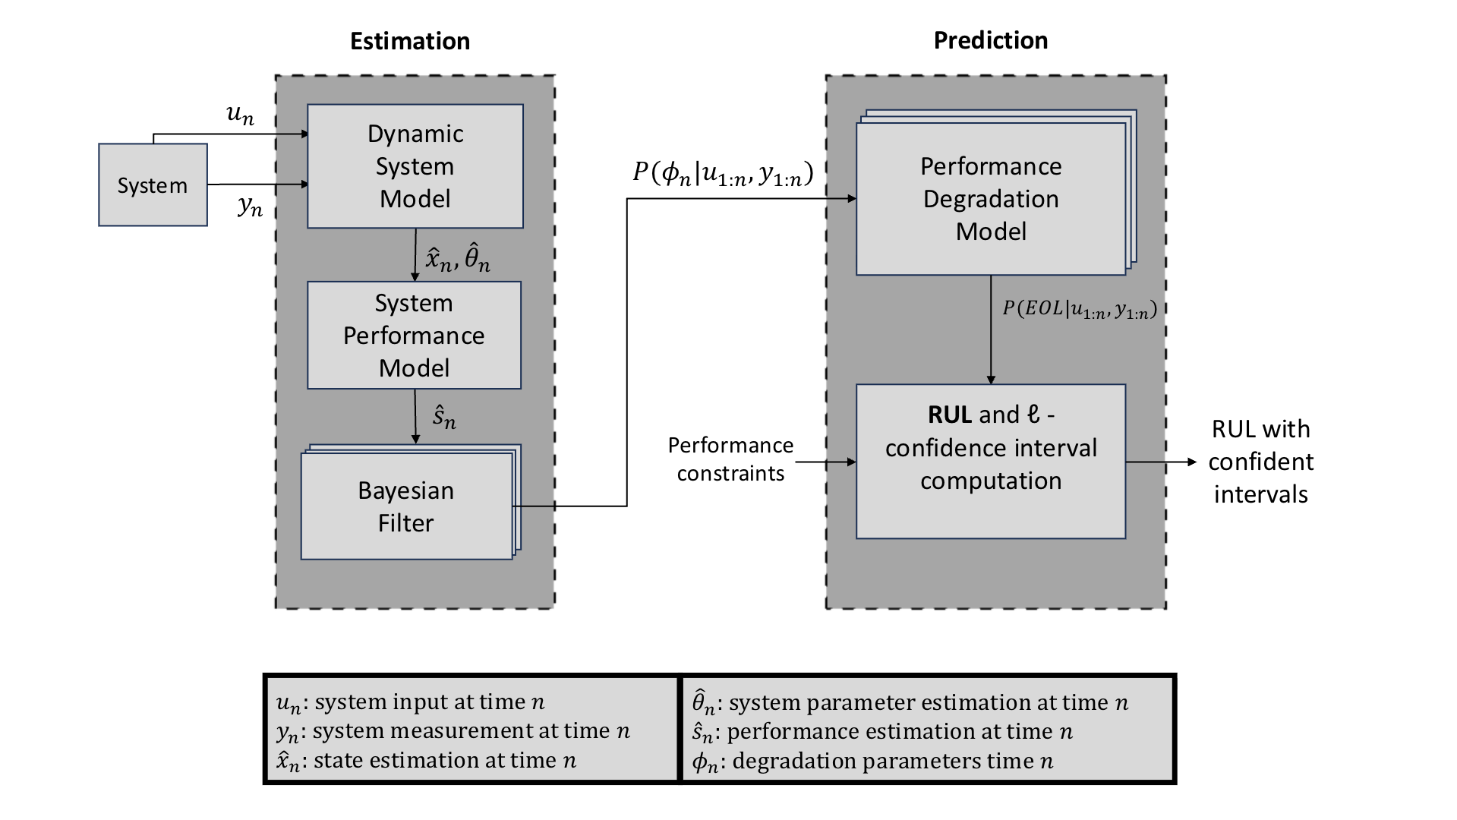

Slide 3

Estimation

Slide 4
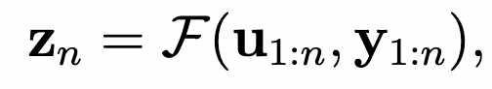
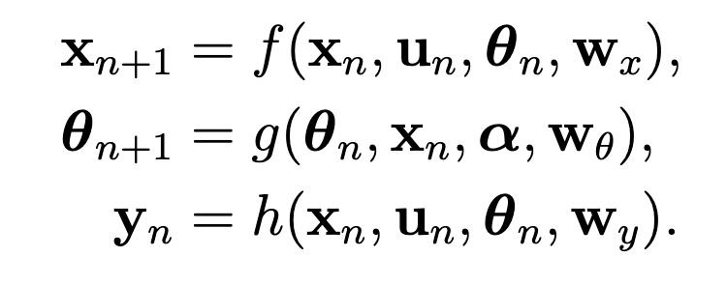
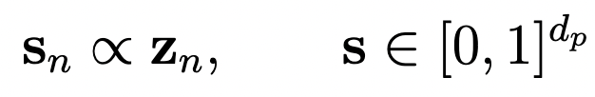
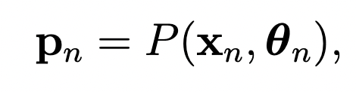
Model Based Prognostics
Proposed method
Data-driven health/performance indicator:
System degradation model
We assume a monotonic trend. Health indicators degrades over time except for random fluctuations.
Scaling to [0,1]
Performance metrics model
Note: Operation condition normalization is used in the paper

Slide 5
Prediction

Slide 6
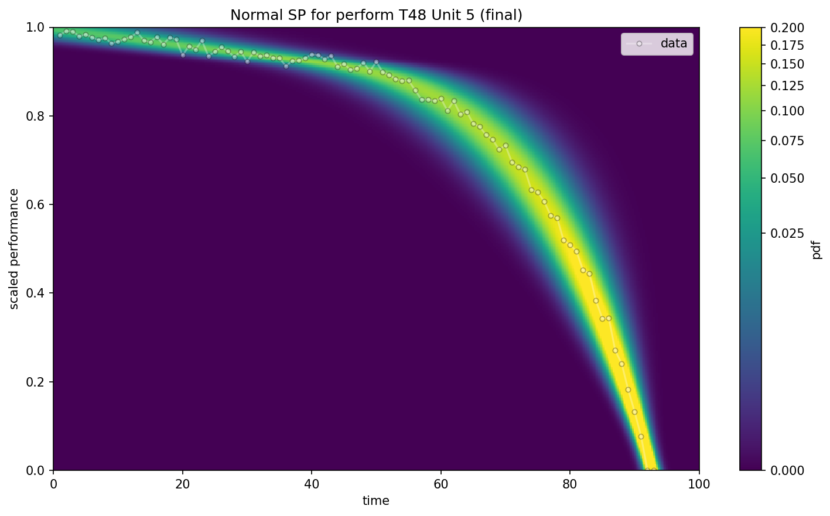
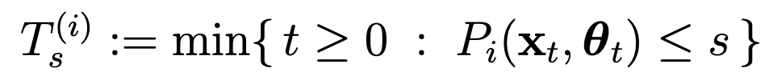
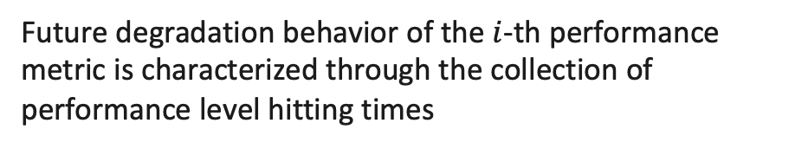
Performance Degradation Model:
Future degradation behavior of the $i$-th performance metric is characterized through the collection of performance level hitting times
Where $s∈[0,1]$ denotes a scalar performance level.

Slide 7
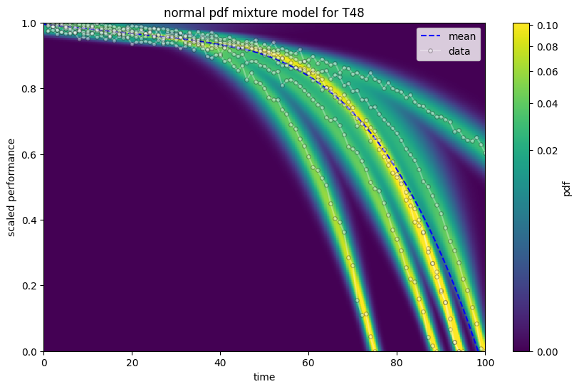
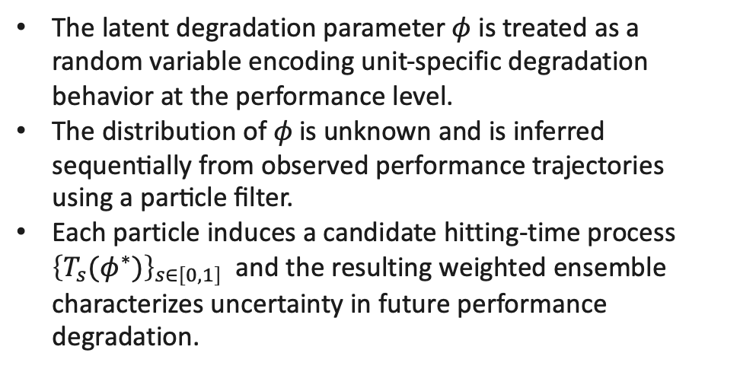

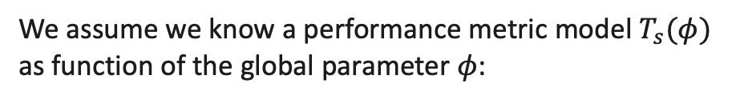
Performance Degradation Model:
We assume we know a performance metric model $T_{s}(φ)$ as function of the global parameter $φ$:
$${\left\{T_{s}(φ)\right\}}_{s∈\left[0,1\right]}$$
The latent degradation parameter $φ$ is treated as a random variable encoding unit-specific degradation behavior at the performance level.
The distribution of $φ \text{is} \text{unknown} \text{and} \text{is} \text{inferred} \text{sequentially} \text{from} \text{observed} \text{performance} \text{trajectories} \text{using} \text{a} \text{particle} \text{filter}\text{.}$
Each particle induces a candidate hitting-time process ${\left\{T_{s}(φ^{∗})\right\}}_{s∈\left[0,1\right]}$ and the resulting weighted ensemble characterizes uncertainty in future performance degradation.

Slide 8
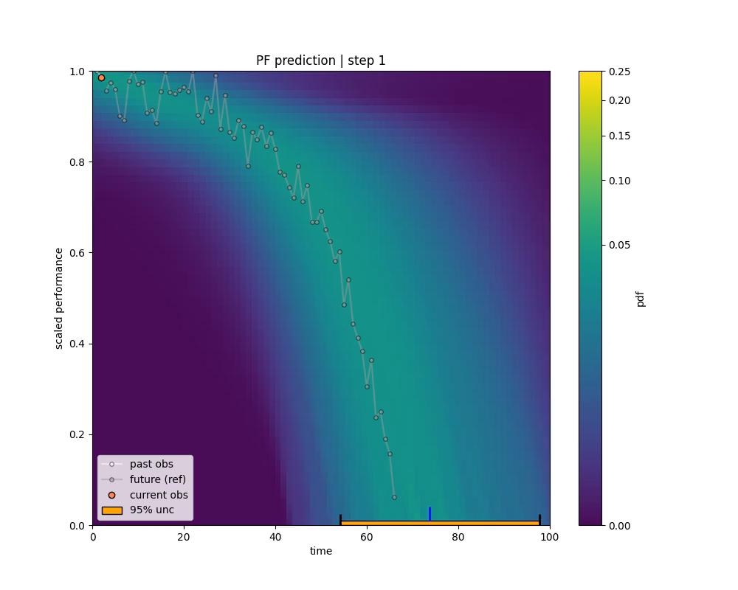
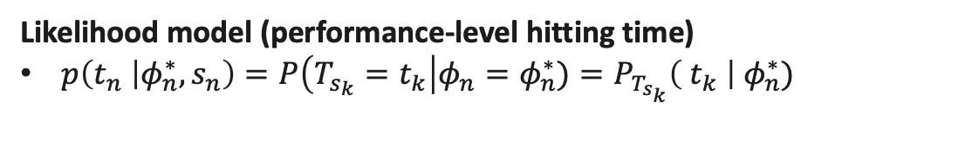
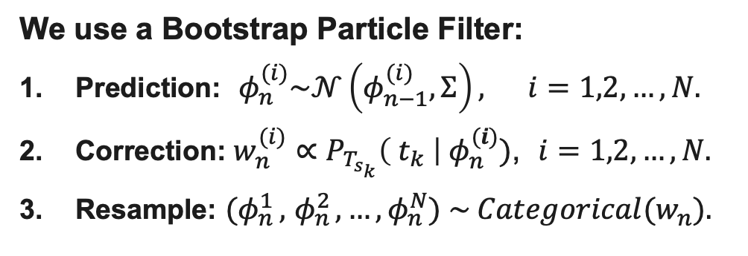
EOL Particle Filter
Each observation $(t_{n}, s_{n})$gives indirect information about $φ$through the performance model $T_{s}(φ)$.
We stimate $φ$ sequentially $φ_{n}, n=1,2,…$, and adopt a pseudo-transition model with Gaussian noise to maintain
particle diversity, as is standard in SMC-based parameter estimation.
Pseudo-transition model (parameter evolution)
$p\left(φ_{n } | φ_{n−1}\right)= 𝒩\left(φ_{n−1},Σ\right), Σ$is diagonal.
Likelihood model (performance-level hitting time)
$p\left(t_{n} | φ_{n}^{∗},s_{n}\right)=P\left(T_{s_{k}}=t_{k}\right|φ_{n}=φ_{n}^{∗})=P_{T_{s_{k}}}\left( t_{k} \right|{ φ}_{n}^{∗})$
We use a Bootstrap Particle Filter:
Prediction: $φ_{n }^{(i)}\sim 𝒩\left(φ_{n−1}^{(i)},Σ\right), i=1,2,…, N.$
Correction: $w_{n}^{(i)}∝P_{T_{s_{k}}}\left( t_{k} \right|{ φ}_{n}^{(i)})$, $i=1,2,…, N.$
Resample: ${(φ}_{n }^{1},$ $φ_{n }^{2}, …,φ_{n }^{N}) \sim Categorical(w_{n}).$

Slide 9
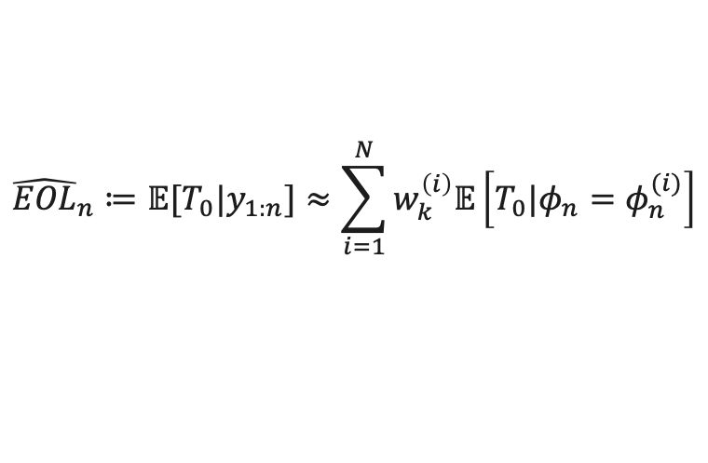
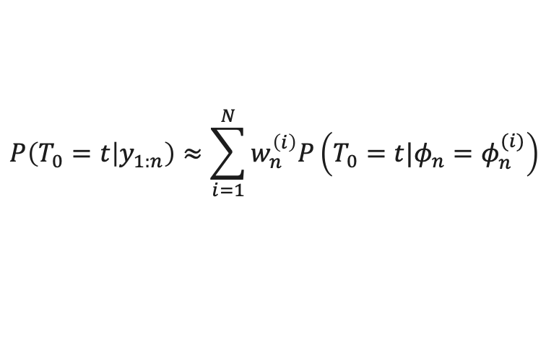
EOL Prediction
In particular, the EOL predictive distribution at time step $k$ can be approximated by
$$P\left(T_{0}=t | y_{1:n}\right)≈\sum_{i=1}^{N}{w_{n}^{\left(i\right)}P\left(T_{0}=t|{φ_{n}=φ}_{n}^{(i)}\right)}$$
We compute the EOL prediction at time $n$ as the mean of the EOL predictive distribution:
$${\hat{EOL}}_{n}≔𝔼[T_{0}|y_{1:n}]≈\sum_{i=1}^{N}{w_{k}^{\left(i\right)}𝔼\left[T_{0}|{φ_{n}=φ}_{n}^{(i)}\right]}$$
To compute a confidence interval at level $ℓ$, we find the quantiles $a$ and $b$ such that $P (a < T_{0} < b|y_{1:n}) = ℓ$.
Final prediction and uncertainty: At each time step, the EOL prediction and confidence interval are obtained by aggregating across performance metrics, using the earliest estimated failure time (mean or quantiles) as the system-level result.

Slide 10
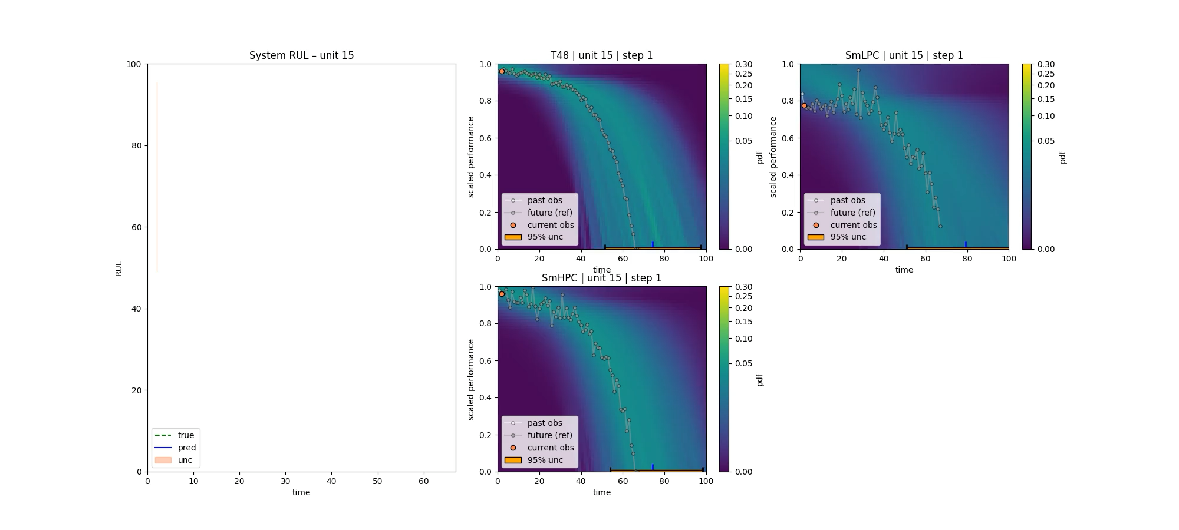

Slide 11

Results

Slide 12
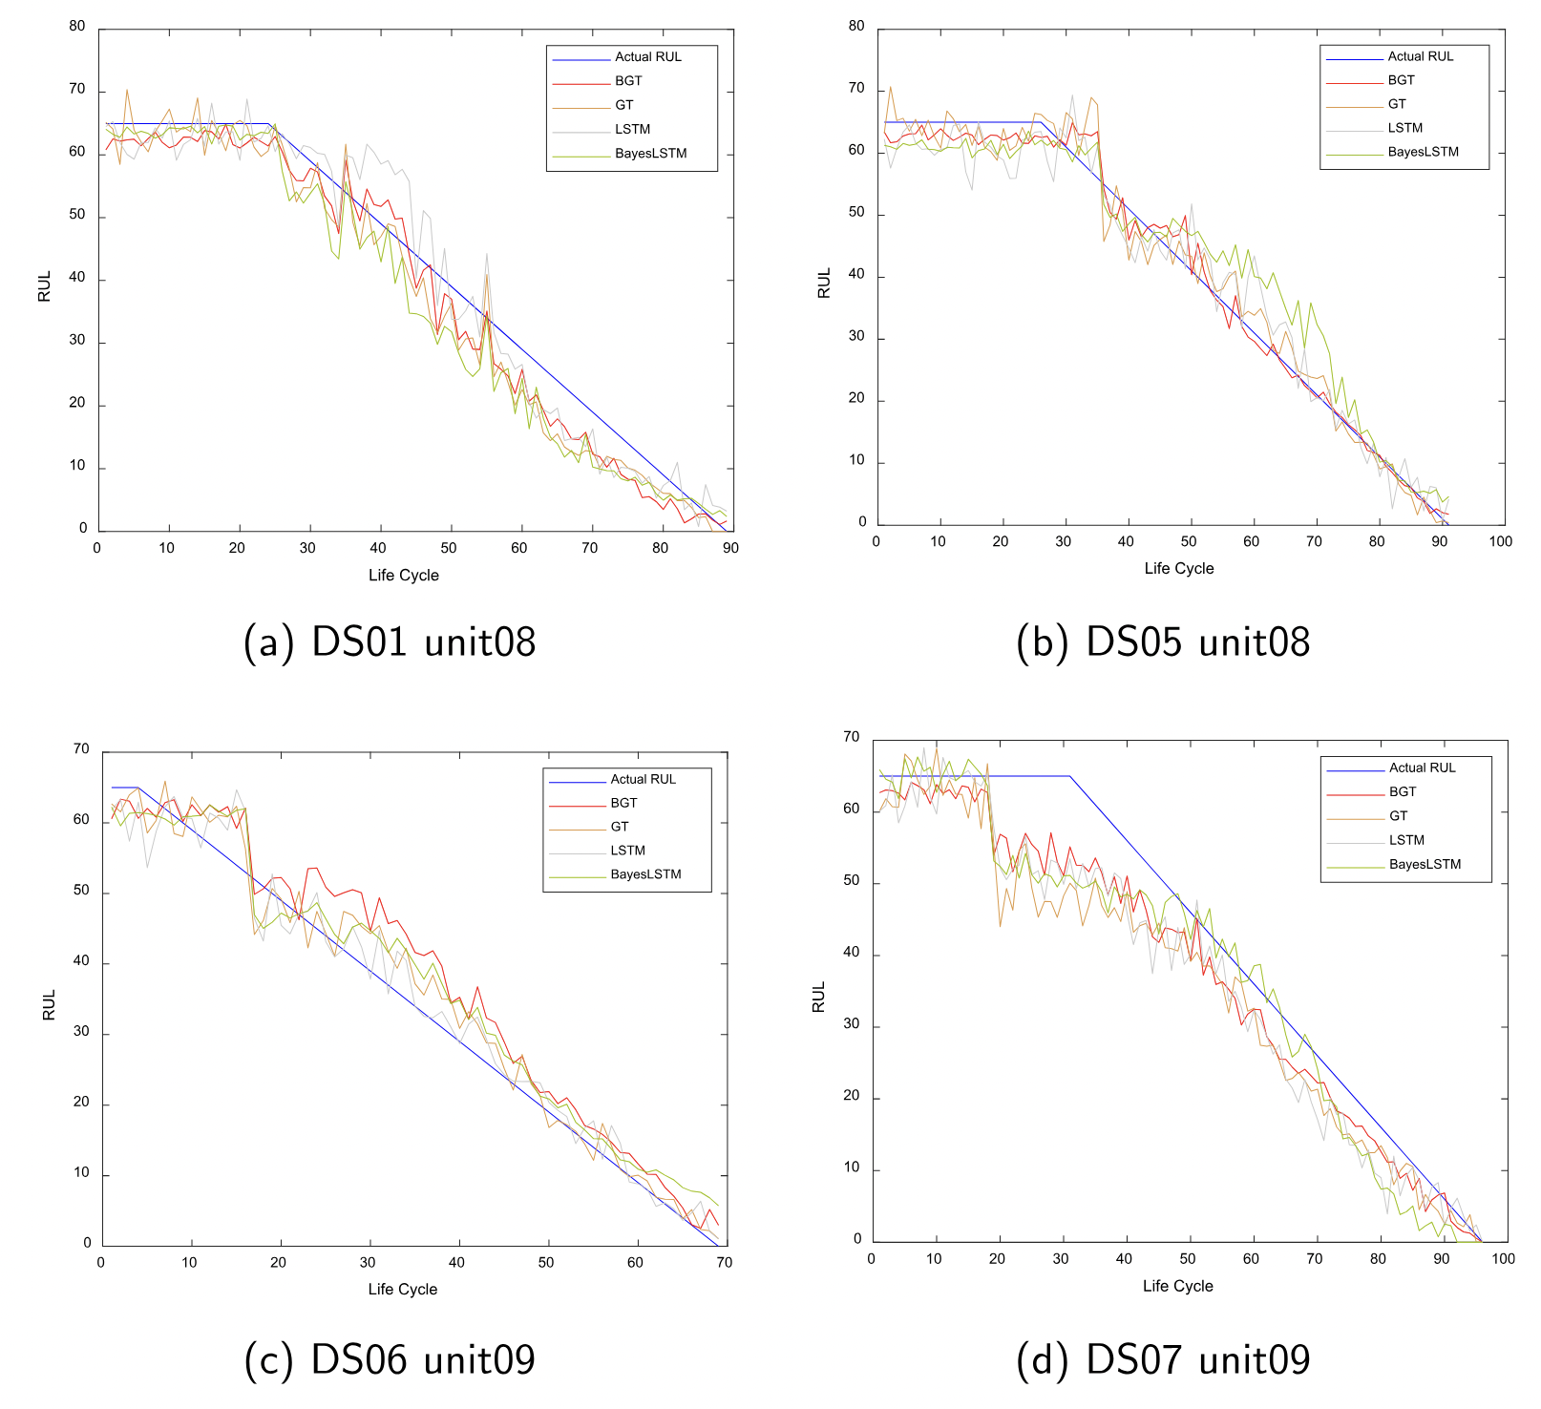
Benchmark Clipping Strategy
65

Slide 13
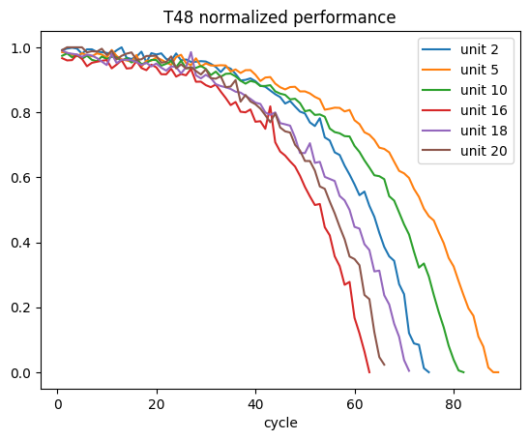
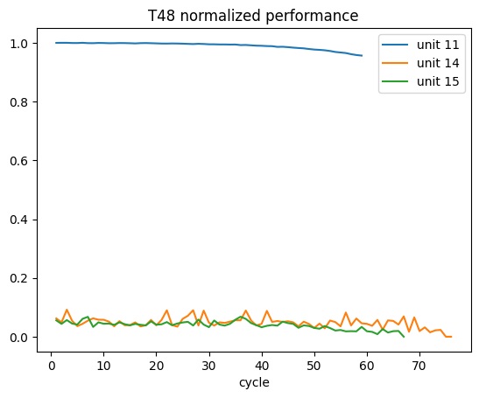
Benchmark on Full life DS02

Slide 14
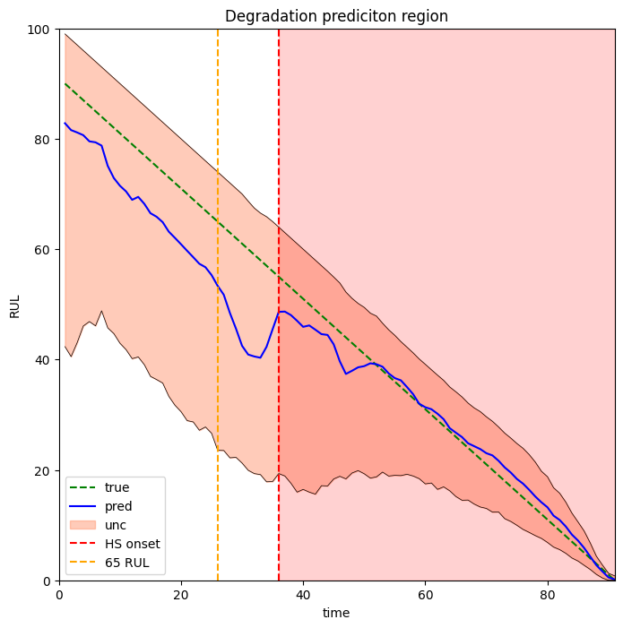
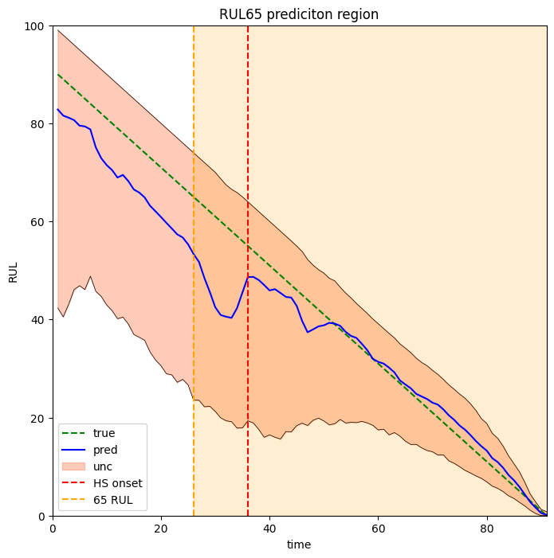
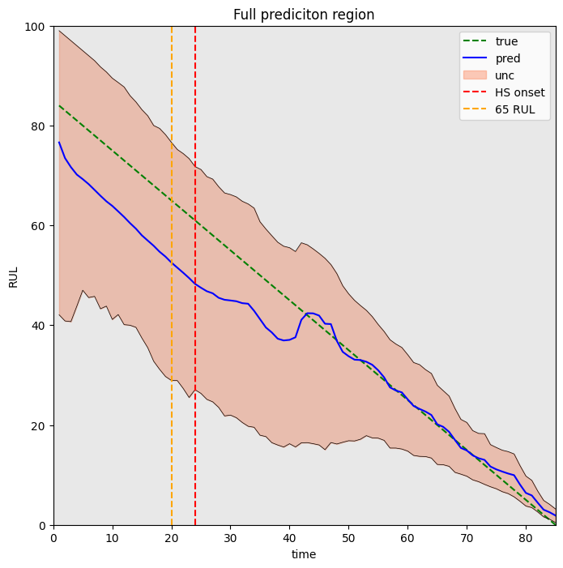
RUL Prediction Across Three Evaluation Regions

Slide 15
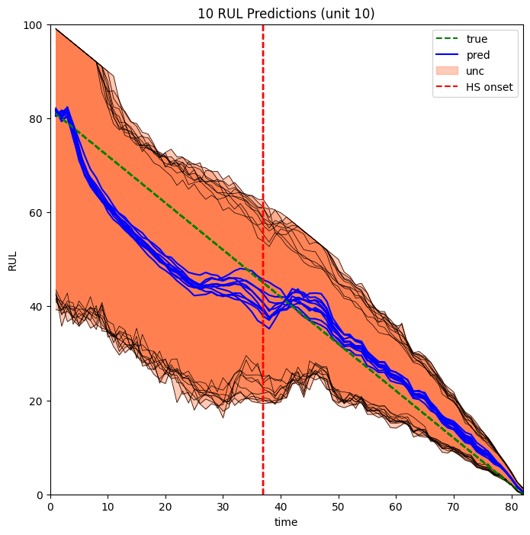
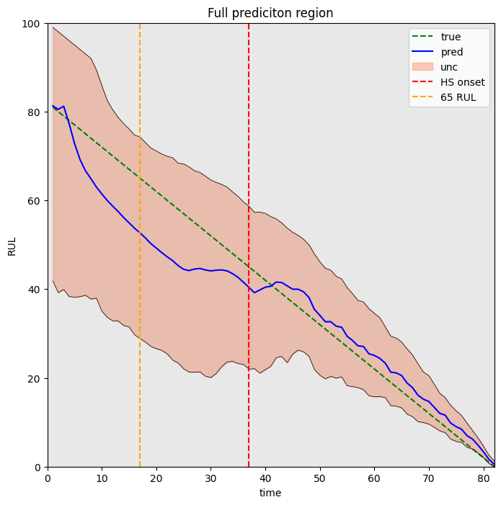
PF-RUL Predictions Averaged Over 10 Independent Runs

Slide 16
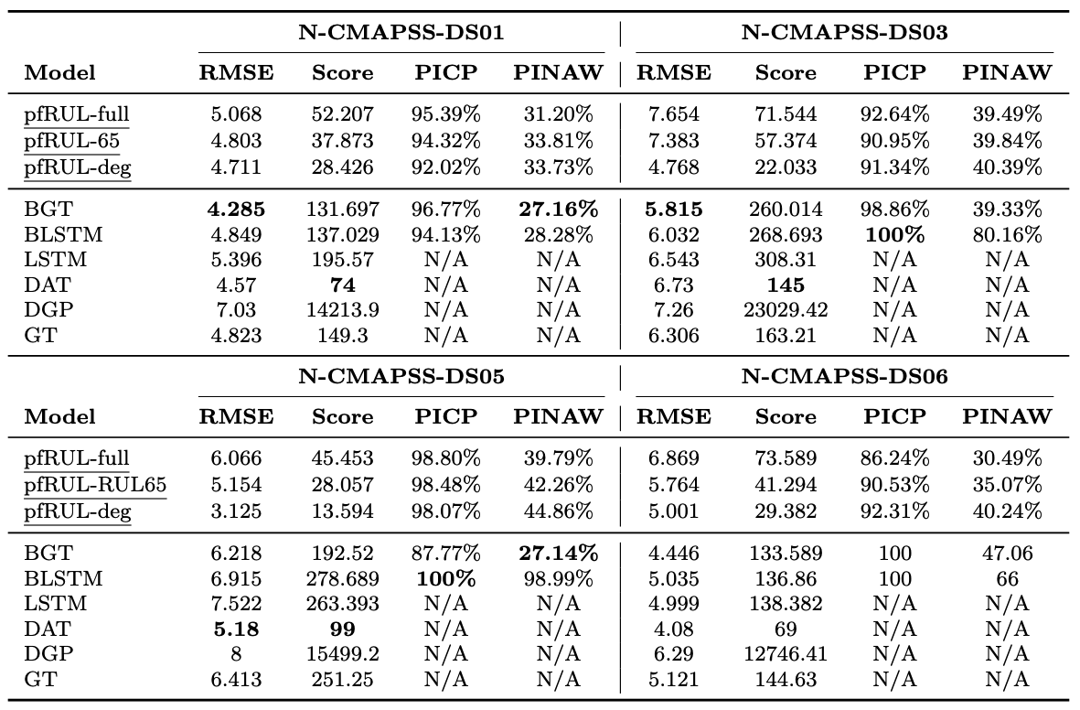
Results
Baseline values for DS01, DS03, DS04 and DS05 taken from Xiang et al. (2024)

Slide 17
Thanks!

Slide 18


Performace model $T_{s}$

Slide 19
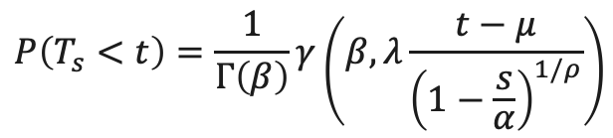
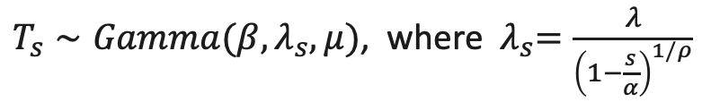
Performance model
We extended the Gamma parametric model presented in [1] to the shifted Gamma distribution.
$T_{s}∼Gamma(β,λ_{s}, μ)$, where ${ λ}_{s}=\frac{λ}{{\left(1−\frac{s}{α}\right)}^{1/ρ}}$
where the degradation parameters are $X=(β,λ,ρ,μ,α)$. The distribution of $T_{s}$ is given by
$$P\left(T_{s}<t\right)=\frac{1}{Γ\left(β\right)}γ\left(β,λ\frac{t−μ}{{\left(1−\frac{s}{α}\right)}^{1/ρ}}\right)$$
where $Γ$and $γ$denote the Gamma and lower incomplete Gamma functions.
In particular, the EOL distribution corresponds to $s = 0$, is given by: $T_{0}∼Gamma\left(β,λ, μ\right).$
[1] Dersin Pierre, Kristupas Bajarunas, and Manuel Arias-Chao. Analytical modeling of health indices for prognostics and health management. In PHM Society European Conference, volume 8, pages 11–11, 2024

Slide 20

Conclusions and
Future Work

Slide 21
Conclusion
Introduced a data-driven particle filtering framework for RUL prediction.
Works without requiring physical models, relying only on performance metrics.
Provides uncertainty-aware predictions, capturing both stochastic and epistemic uncertainty
Offers interpretability through performance-indexed degradation trajectories
Validated on a high-fidelity UAV simulation dataset.
Combines statistical rigor with data-driven flexibility, offering a principled alternative to black-box methods

Slide 22
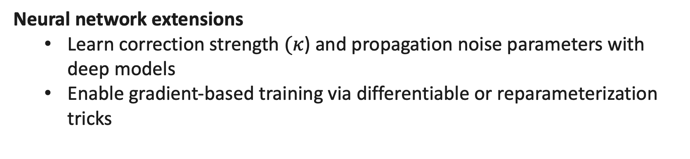
Future Work
Benchmark evaluation
Apply method to N-CMAPSS dataset and real-world data
Neural network extensions
Learn correction strength $(κ$) and propagation noise parameters with deep models
Enable gradient-based training via differentiable or reparameterization tricks

Slide 23

Background

Slide 24
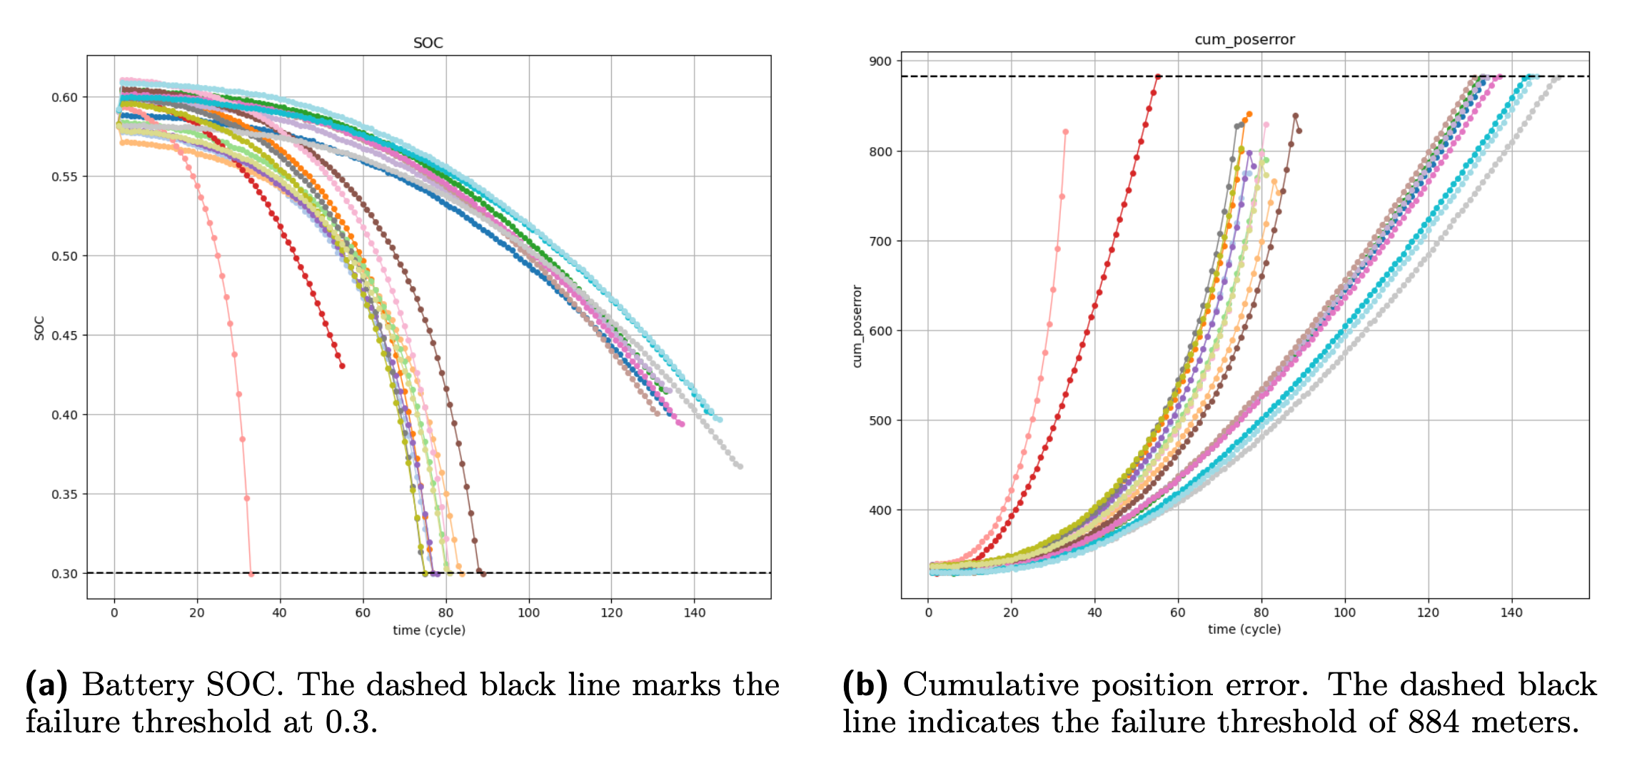
Dataset: N-CMAPSS

Slide 25
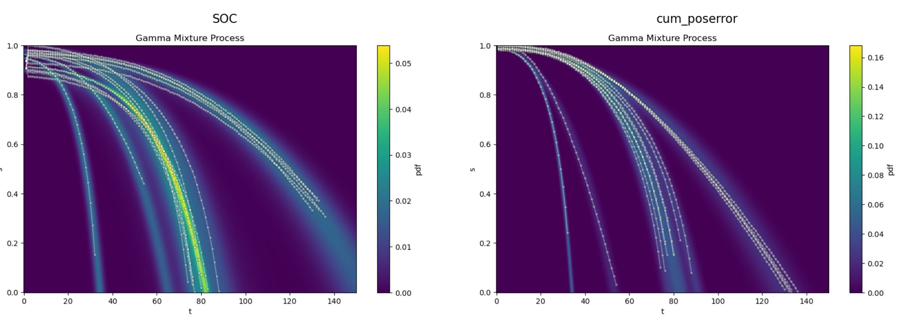

Initial distribution $P(X_{0})$

Slide 26
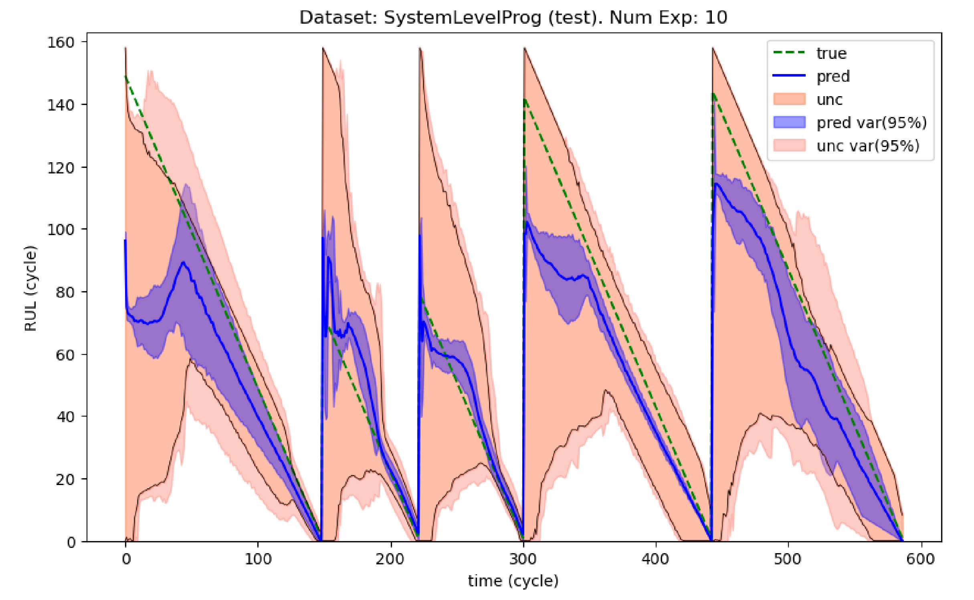
Predicted RUL

Slide 27
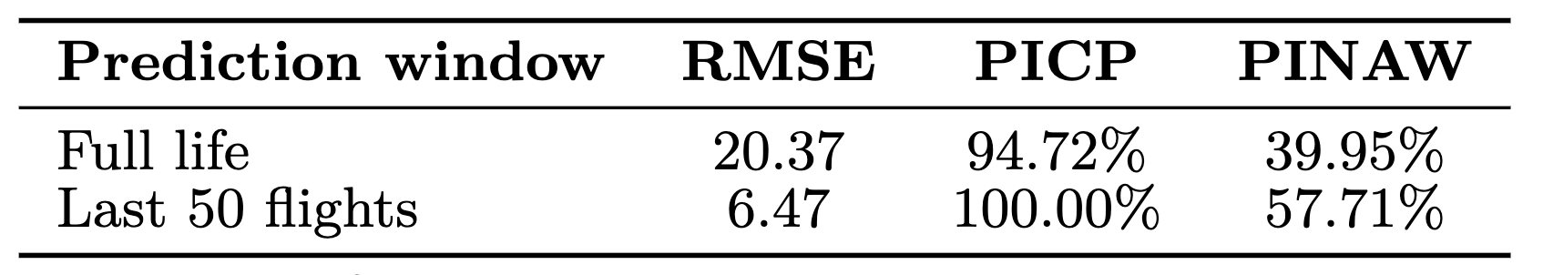
Evaluation
Evaluation metrics
RMSE – measures prediction accuracy
PICP – percentage of true RUL within prediction intervals
PINAW – width of prediction intervals (normalized)
The method becomes more accurate and reliable near failure, while still providing meaningful uncertainty estimates across the full life cycle.

Slide 28
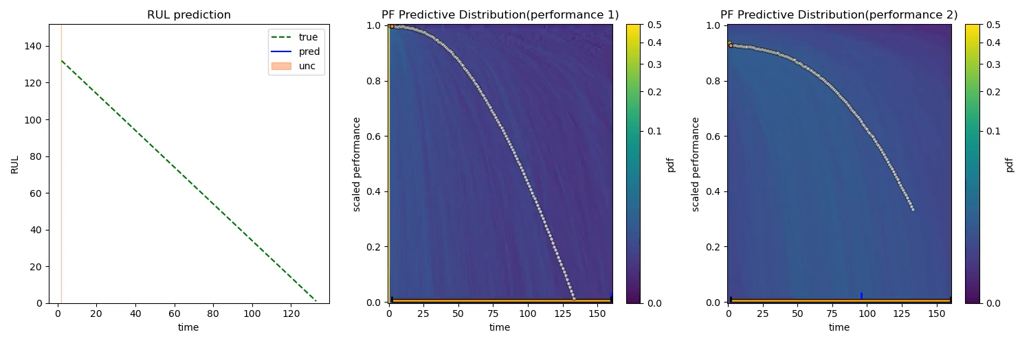
Predictive distribution

Slide 29
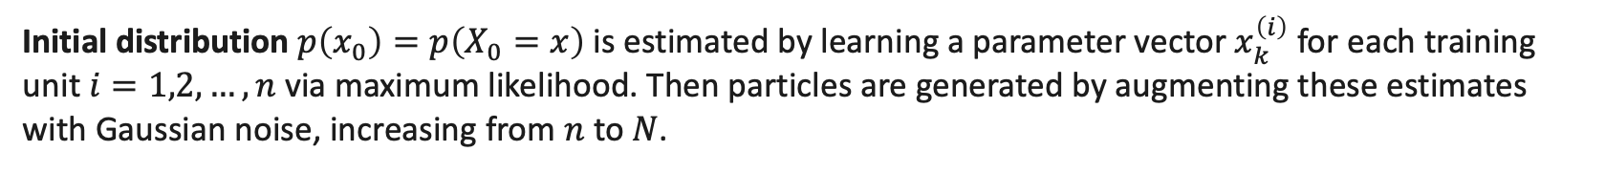
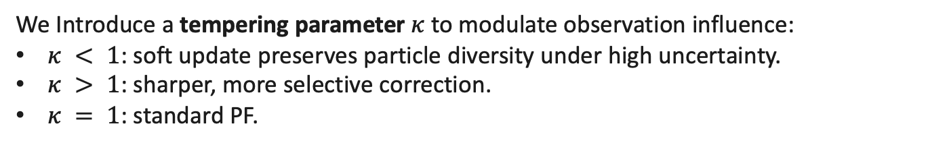
EOL Particle Filter
We use the standard bootstrap PF algorithm with a modified correction step for parameter inference.
We Introduce a tempering parameter $κ$to modulate observation influence:
$κ < 1$: soft update preserves particle diversity under high uncertainty.
$κ > 1$: sharper, more selective correction.
$κ = 1$: standard PF.
${\tilde{w}}_{k}^{(i)}=p{\left(y_{k} | {\tilde{x}}_{k}^{\left(i\right)}\right)}^{κ}$
$κ$and propagation noise variances ($Σ$) are learned offline as a function of the observation (not just as fixed constants) from historical data.
Initial distribution $p\left(x_{0}\right)=p\left(X_{0}=x\right)$ is estimated by learning a parameter vector $x_{k}^{\left(i\right)}$ for each training unit $i=1,2,…,n$ via maximum likelihood. Then particles are generated by augmenting these estimates with Gaussian noise, increasing from $n$ to $N$.

Slide 30

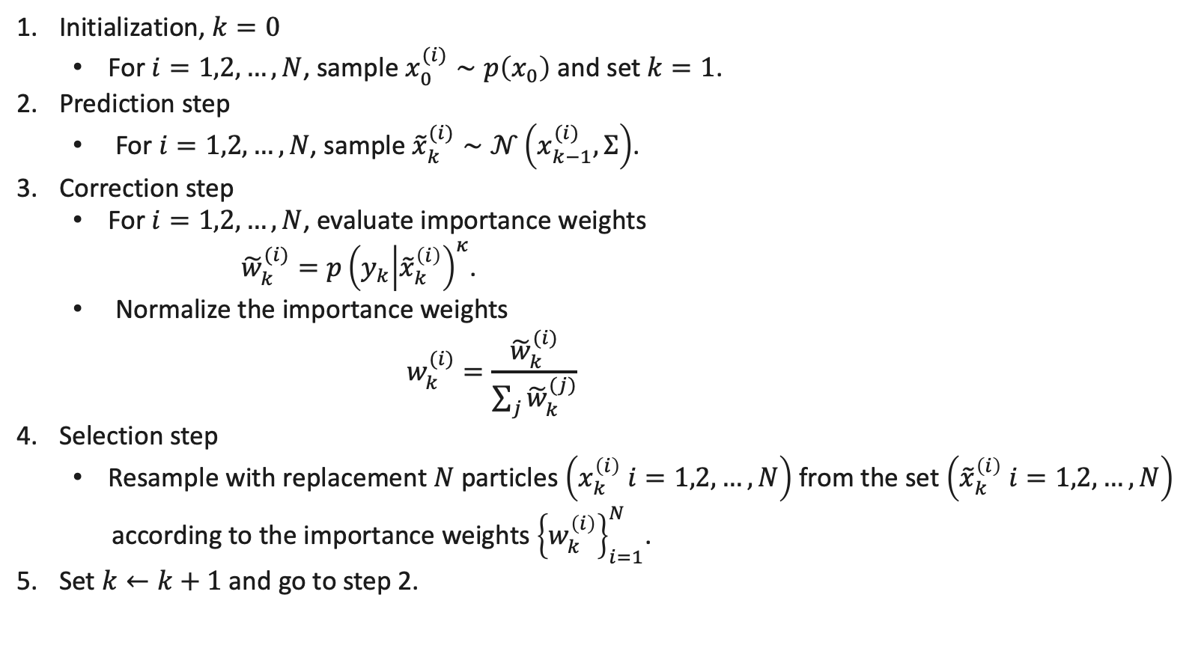
EOL Particle Filter ($N$ particles)
Initialization, $k=0$
For $i=1,2,…,N$, sample $x_{0}^{(i)}∼p\left(x_{0}\right)$ and set $k=1$.
Prediction step
For $i=1,2,…,N$, sample ${\tilde{x}}_{k}^{(i)}∼𝒩\left(x_{k−1}^{(i)},Σ\right)$.
Correction step
For $i=1,2,…,N$, evaluate importance weights
${\tilde{w}}_{k}^{(i)}=p{\left(y_{k} | {\tilde{x}}_{k}^{\left(i\right)}\right)}^{κ}$.
Normalize the importance weights
$$w_{k}^{(i)}=\frac{{\tilde{w}}_{k}^{(i)}}{\sum_{j}{{\tilde{w}}_{k}^{(j)}}}$$
Selection step
Resample with replacement $N$ particles $\left(x_{k}^{\left(i\right)} i=1,2,…,N\right)$ from the set $\left({\tilde{x}}_{k}^{\left(i\right)} i=1,2,…,N\right)$
according to the importance weights ${\left\{w_{k}^{\left(i\right)}\right\}}_{i=1}^{N}$.
Set $k←k+1$ and go to step 2.

Slide 31
Particle Filter (PF)
PFs are a class of Bayesian filters that use sequential Monte Carlo sampling to approximate the posterior distribution of latent variables with a set of weighted samples or “particles”.
At time step $k$, the goal is to estimate the posterior distribution of the latent variable $X_{k}$ given all observations $y_{0:k}$.
This posterior is often referred as the belief ${bel}_{k}$ and is computed in two recursive steps:
$$bel_{k}\left(x_{k}\right)≔p\left(X_{k}=x_{k} | Y_{0:k−1}=y_{0:k−1}\right)=∫p\left(x_{k} | x_{k−1}\right){\overline{bel}}_{k−1}\left(x_{k−1}\right)dx_{k−1}$$
(prediction)
$${\overline{bel}}_{k}\left(x_{k}\right)≔p\left(X_{k}=x_{k} | Y_{0:k}=y_{0:k}\right)∝p\left(y_{k} | x_{k}\right)bel_{k}(x_{k})$$
(correction)
Notice that the particle filtering framework depends only on the transition $p\left(x_{k} | x_{k−1}\right)$ and sensor $p\left(y_{k} | x_{k}\right)$ models and the initial distribution of the latent variable $bel_{0}\left(x\right)=p\left(X_{0}=x\right).$

Slide 32

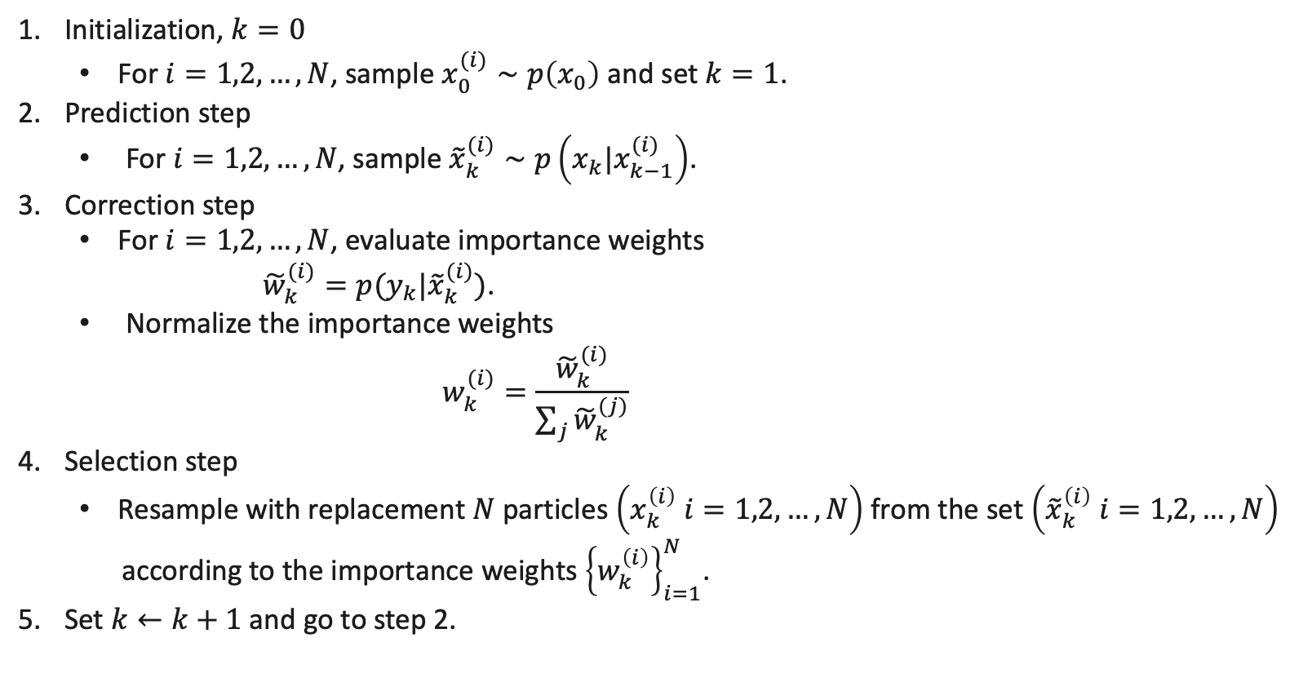
Bootstrap Particle Filter ($N$ particles)
Initialization, $k=0$
For $i=1,2,…,N$, sample $x_{0}^{(i)}∼p\left(x_{0}\right)$ and set $k=1$.
Prediction step
For $i=1,2,…,N$, sample ${\tilde{x}}_{k}^{(i)}∼p\left(x_{k}|x_{k−1}^{(i)}\right)$.
Correction step
For $i=1,2,…,N$, evaluate importance weights
${\tilde{w}}_{k}^{(i)}=p(y_{k}|{\tilde{x}}_{k}^{(i)})$.
Normalize the importance weights
$$w_{k}^{(i)}=\frac{{\tilde{w}}_{k}^{(i)}}{\sum_{j}{{\tilde{w}}_{k}^{(j)}}}$$
Selection step
Resample with replacement $N$ particles $\left(x_{k}^{\left(i\right)} i=1,2,…,N\right)$ from the set $\left({\tilde{x}}_{k}^{\left(i\right)} i=1,2,…,N\right)$
according to the importance weights ${\left\{w_{k}^{\left(i\right)}\right\}}_{i=1}^{N}$.
Set $k←k+1$ and go to step 2.

Slide 33
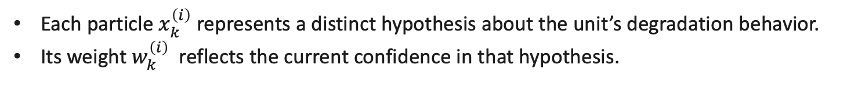
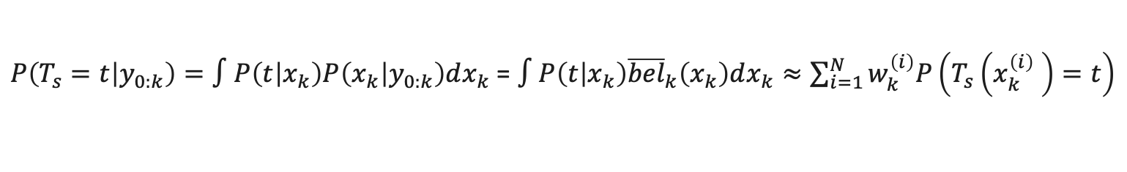
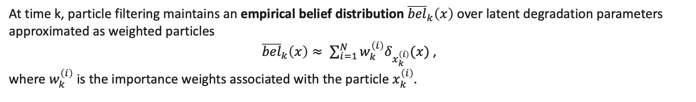
Predictive distribution
At time k, particle filtering maintains an empirical belief distribution ${\overline{bel}}_{k}\left(x\right)$ over latent degradation parameters approximated as weighted particles
${\overline{bel}}_{k}\left(x\right)≈ \sum_{i=1}^{N}{w_{k}^{\left(i\right)}δ_{x_{k}^{\left(i\right)}}(x)}$ ,
where $w_{k}^{\left(i\right)}$ is the importance weights associated with the particle $x_{k}^{\left(i\right)}.$
We use this empirical belief distribution to compute the predictive probability distribution of $T_{s}$, marginalizing over the posterior distribution of $X_{k}$
$P\left(T_{s}=t | y_{0:k}\right)=∫P\left(t | x_{k}\right)P\left(x_{k} | y_{0:k}\right)dx_{k}$ = $∫P\left(t | x_{k}\right){\overline{bel}}_{k}\left(x_{k}\right)dx_{k}≈\sum_{i=1}^{N}{w_{k}^{\left(i\right)}P\left(T_{s}\left(x_{k}^{\left(i\right)} \right)=t\right)}$
Each particle $x_{k}^{\left(i\right)}$ represents a distinct hypothesis about the unit’s degradation behavior.
Its weight $w_{k}^{\left(i\right)}$reflects the current confidence in that hypothesis.

